Slide 1
Hashing
Diptarka Chakraborty

Slide 2
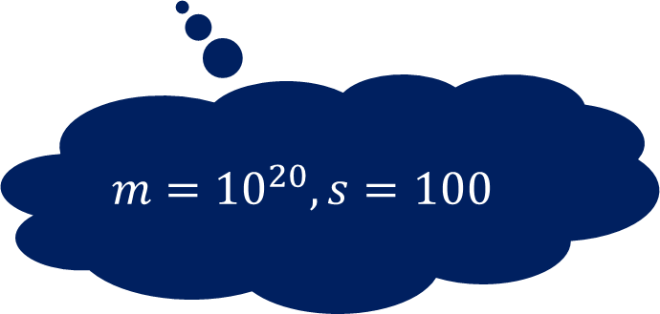
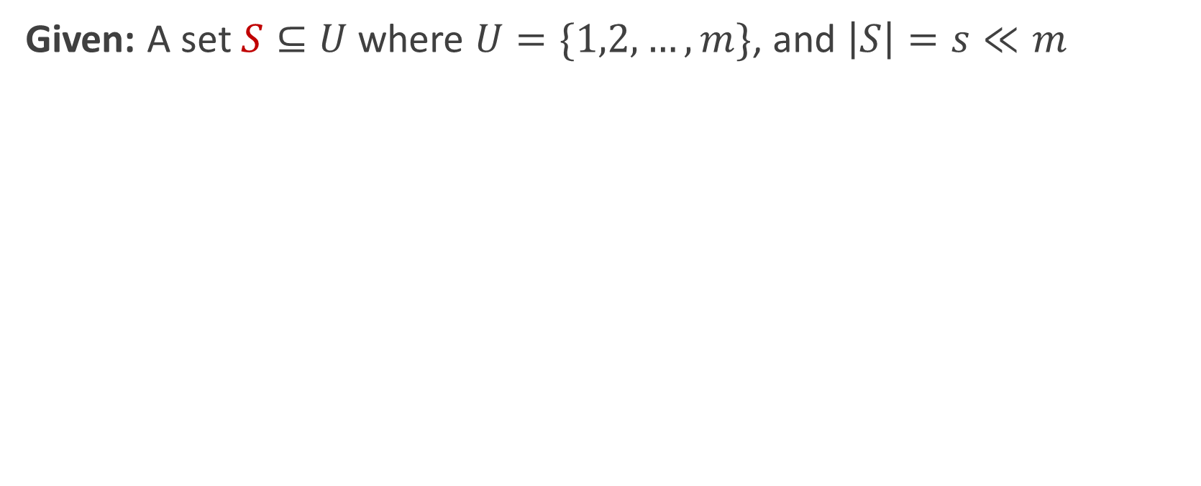

Problem Definition
Given: A set $S⊆U$ where $U=\{1,2,…,m\}$, and $\left|S\right|=s≪m$
$$m={10}^{20}, s=100$$
Goal: Maintain a data structure for a given $S$to support the search query : “Does $i∈S?$”

Slide 3
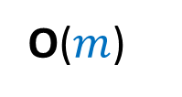
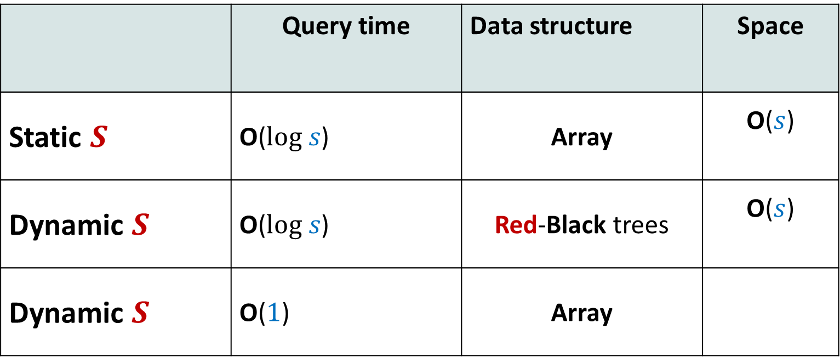
Worst case guarantee
 | Query time | Data structure | Space
Static $S$ | O($log s$) | Array | O($s$)
Dynamic $S$ | O($log s$) | Red-Black trees | O($s$)
Dynamic $S$ | O($1$) | Array
O($m$)

Slide 4
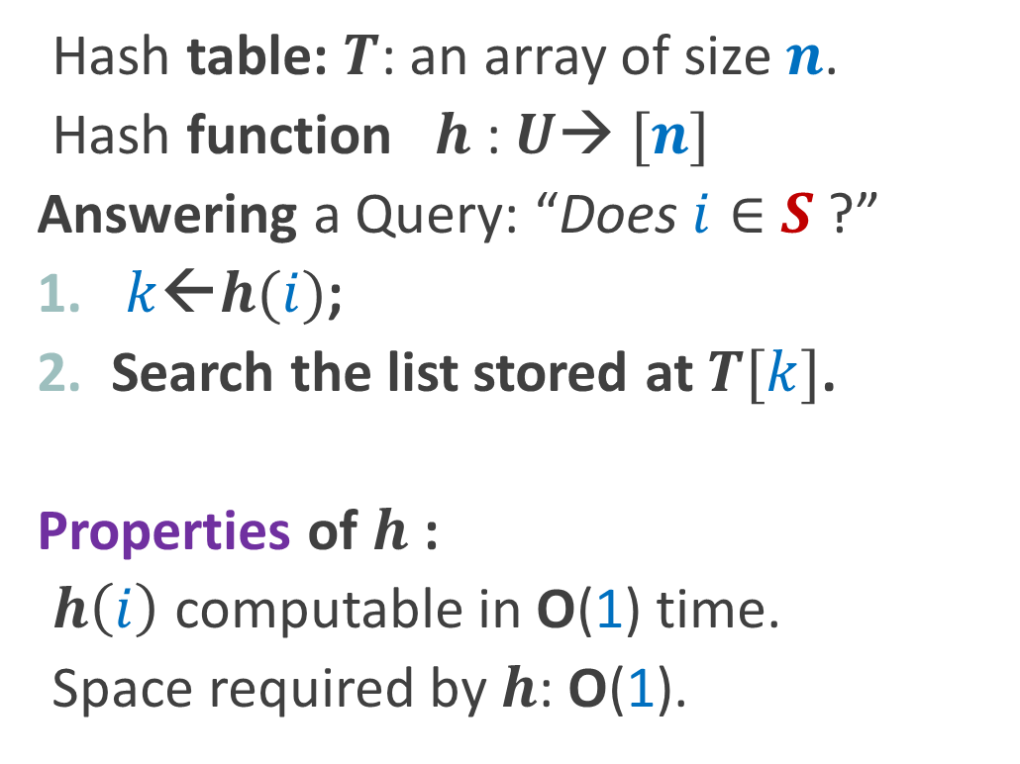
Hashing - a practical solution
Hash table: $T$: an array of size $n$.
Hash function $h$: $U$→ $[n]$
Answering a Query: “Does $i∈$ $S$ ?”
$k$←$h(i)$;
Search the list stored at $T[k]$.
Properties of $h$:
$h\left(i\right)$ computable in O(1) time.
Space required by $h$: O(1).
No. of words needed to encode

Slide 5
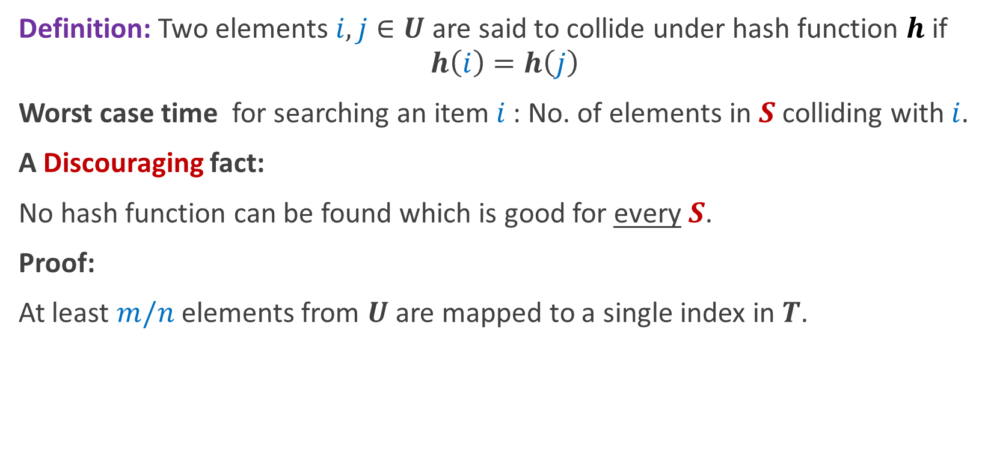
Collision
Definition: Two elements $i,j∈U$ are said to collide under hash function $h$ if
$$h\left(i\right)=h\left(j\right)$$
Worst case time for searching an item $i$: No. of elements in $S$ colliding with $i$.
A Discouraging fact:
No hash function can be found which is good for every $S$.
Proof:
At least $m/n$ elements from $U$are mapped to a single index in $T$.

Slide 6
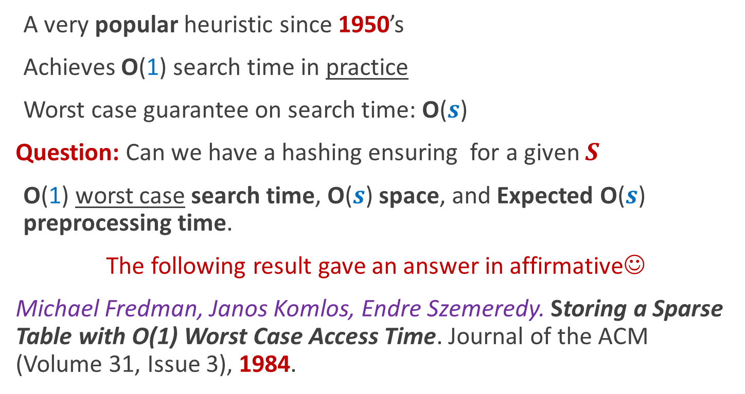
History of Hashing
A very popular heuristic since 1950’s
Achieves O(1) search time in practice
Worst case guarantee on search time: O($s$)
Question: Can we have a hashing ensuring for a given $S$
O(1) worst case search time, O($s$) space, and Expected O($s$) preprocessing time.
The following result gave an answer in affirmative☺
Michael Fredman, Janos Komlos, Endre Szemeredy. Storing a Sparse Table with O(1) Worst Case Access Time. Journal of the ACM (Volume 31, Issue 3), 1984.

Slide 7
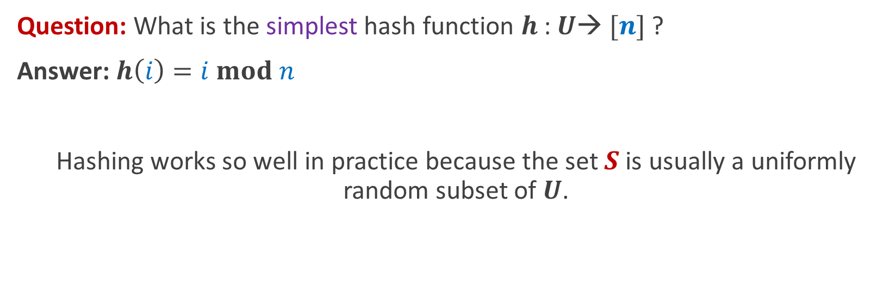
Why does Hashing work well in practice?
Question: What is the simplest hash function $h$: $U$→ $[n]$ ?
Answer: $h\left(i\right)=i mod n$
Hashing works so well in practice because the set $S$ is usually a uniformly random subset of $U$.

Slide 8
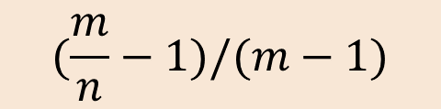
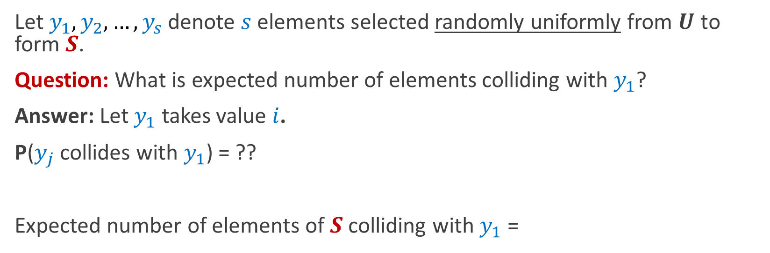
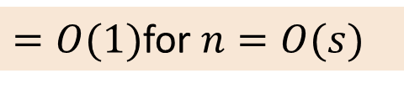
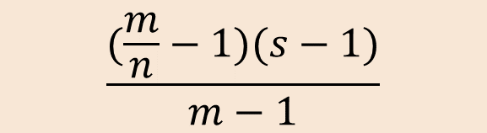
Why does Hashing work well in practice?
Let $y_{1},y_{2},…,y_{s}$ denote $s$elements selected randomly uniformly from $U$ to form $S$.
Question: What is expected number of elements colliding with $y_{1}$?
Answer: Let $y_{1}$ takes value $i$.
P($y_{j}$ collides with $y_{1}$) = ??
Expected number of elements of $S$ colliding with $y_{1}$ =
$$(\frac{m}{n}−1)/(m−1)$$
$$\frac{(\frac{m}{n}−1)(s−1)}{m−1}$$
Expected no. of collisions at an index in T
$=O(1)$for $n=O(s)$

Slide 9
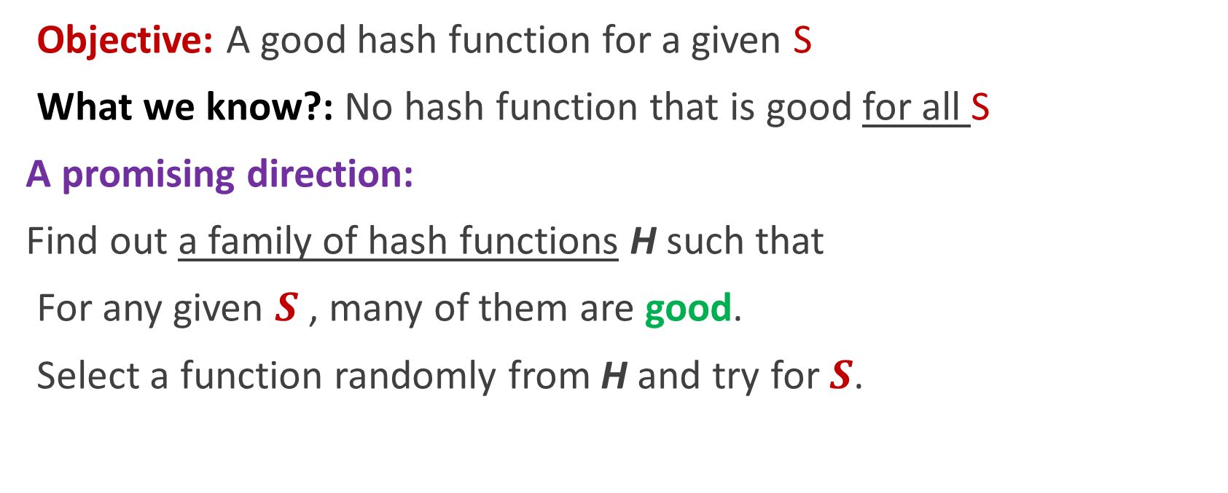
How to achieve O(1) worst case search time?
Objective: A good hash function for a given S
What we know?: No hash function that is good for all S
A promising direction:
Find out a family of hash functions H such that
For any given $S$ , many of them are good.
Select a function randomly from H and try for $S$.
Formally captured by the definition of Universal Hash Function

Slide 10
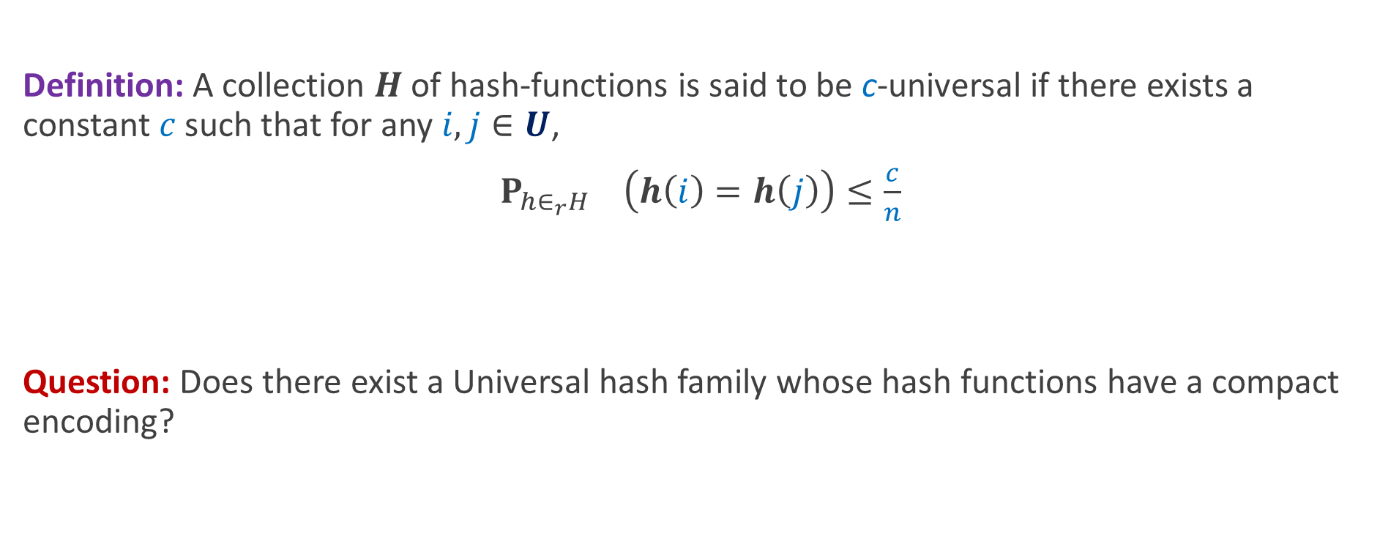
Universal Hash Family
Definition: A collection $H$of hash-functions is said to be c-universal if there exists a constant $c$such that for any $i,j∈U$,
$P_{h∈_{r}H} \left(h\left(i\right)=h\left(j\right)\right)≤\frac{c}{n}$
Question: Does there exist a Universal hash family whose hash functions have a compact encoding?
YES! Also very simple ☺

Slide 11
Static Hashing (worst case O(1) search time)
Michael Fredman, Janos Komlos, Endre Szemeredy.
Storing a Sparse Table with O(1) Worst Case Access Time.
Journal of the ACM (Volume 31, Issue 3), 1984.
First step: A perfect hash function
Main tool: Universal Hash Family

Slide 12
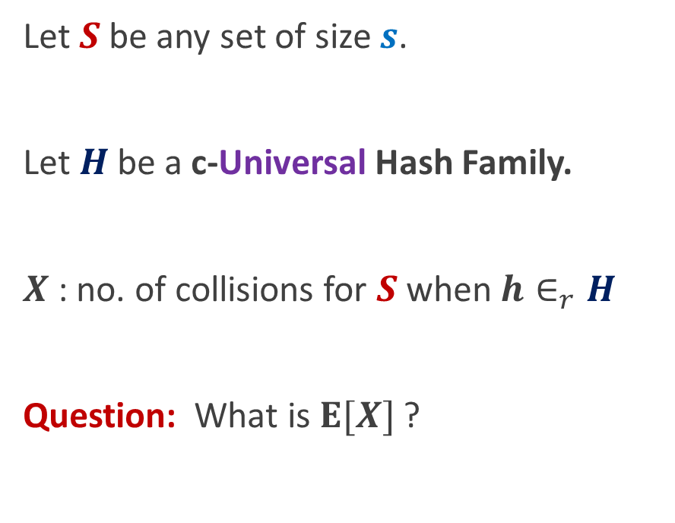

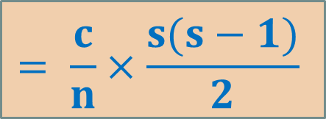
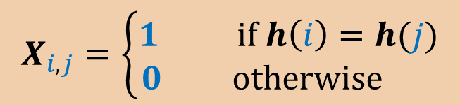

Perfect Hashing using $O(s^{2})$space
Let $S$ be any set of size $s$.
Let $H$be a c-Universal Hash Family.
$X$: no. of collisions for $S$ when $h∈_{r}H$
Question: What is $E[X]$?
For each $i, j∈S$ define the following
$$X_{i,j}=\left\{\begin{aligned}1 if h\left(i\right)=h(j) \\ 0 otherwise \end{aligned}\right.$$
$$= \frac{c}{n}×\frac{s(s−1)}{2}$$

Slide 13
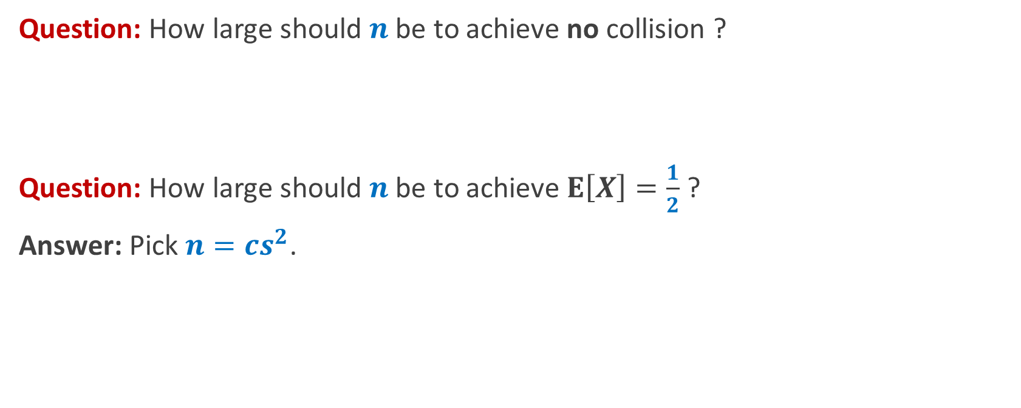
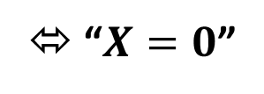
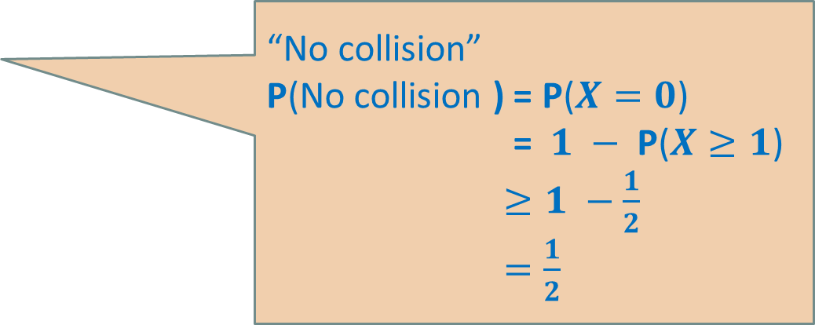
Perfect Hashing using $O(s^{2})$space
Question: How large should $n$be to achieve no collision ?
Question: How large should $n$be to achieve $E\left[X\right]=\frac{1}{2}$ ?
Answer: Pick $n=cs^{2}$.
“No collision”
P(No collision ) = P($X=0$)
= $1 −$ P($X≥1$)
$≥1 −\frac{1}{2}$
$=\frac{1}{2}$
⬄ “$X=0$”

Slide 14
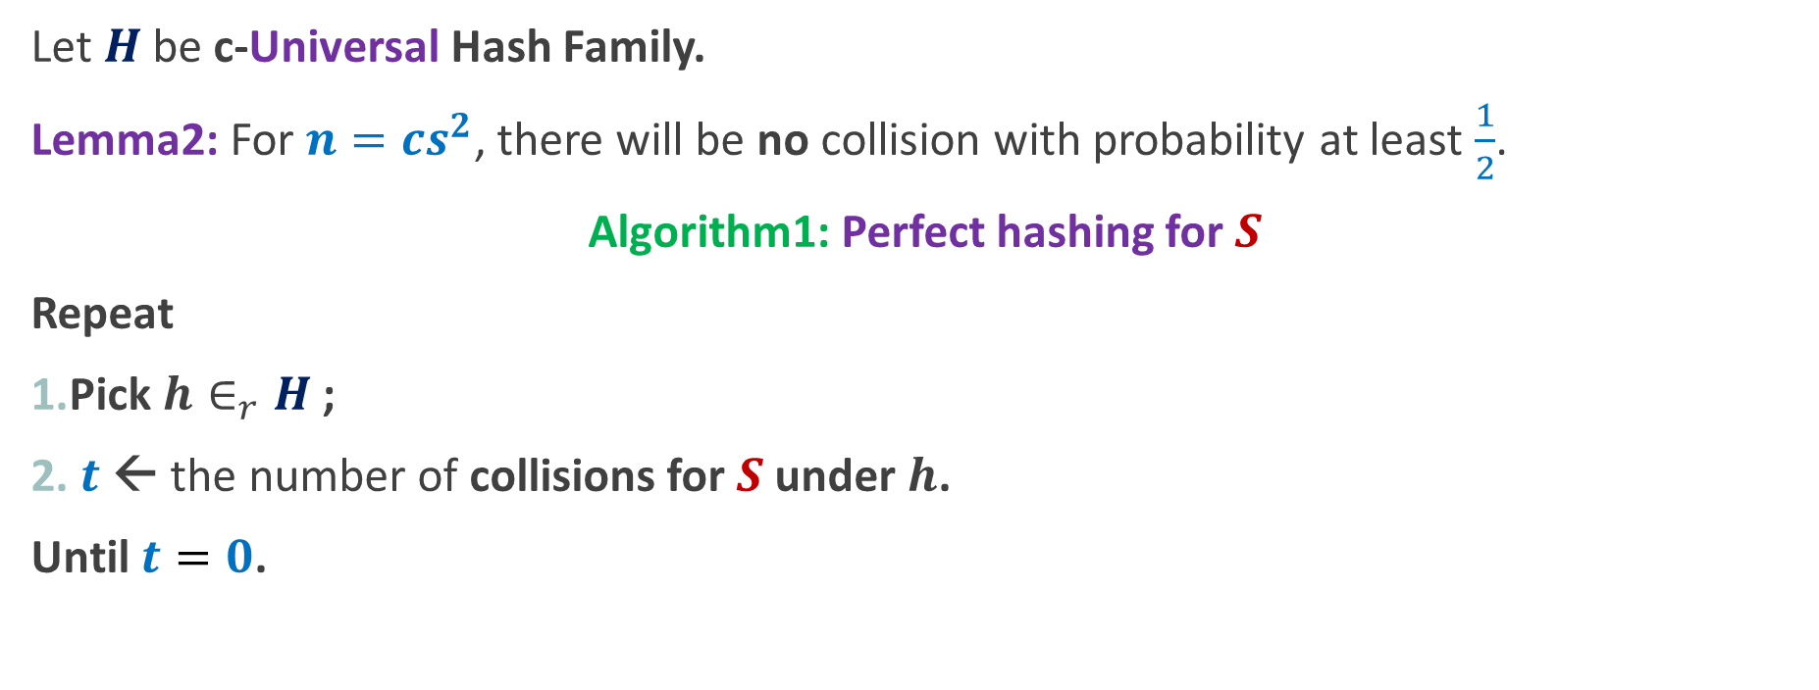
Perfect Hashing using $O(s^{2})$space
Let $H$be c-Universal Hash Family.
Lemma2: For $n=cs^{2}$, there will be no collision with probability at least $\frac{1}{2}$.
Algorithm1: Perfect hashing for $S$
Repeat
Pick $h∈_{r}H$;
$t$← the number of collisions for $S$ under $h$.
Until $t=0$.

Slide 15
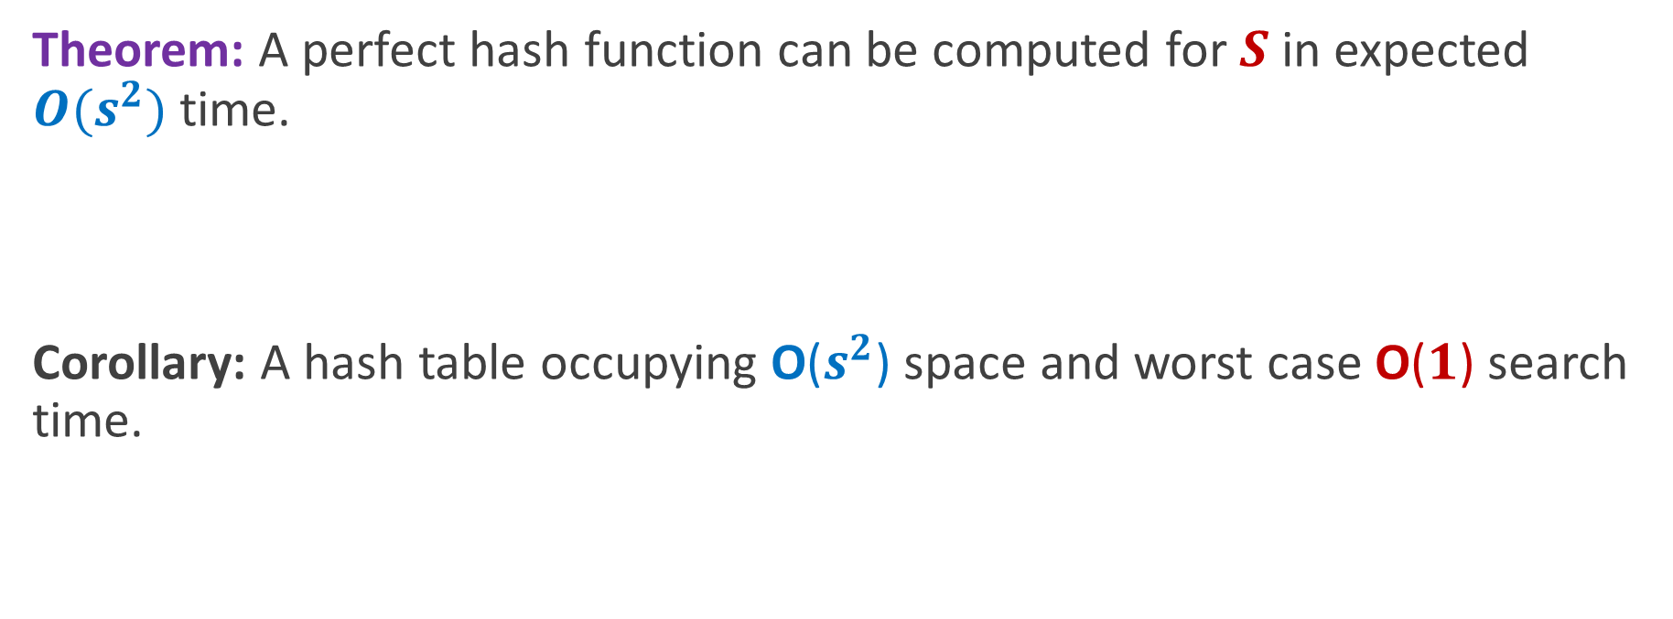
Perfect Hashing using $O(s^{2})$space
Theorem: A perfect hash function can be computed for $S$in expected $O(s^{2})$ time.
Corollary: A hash table occupying O($s^{2}$) space and worst case O($1$) search time.

Slide 16
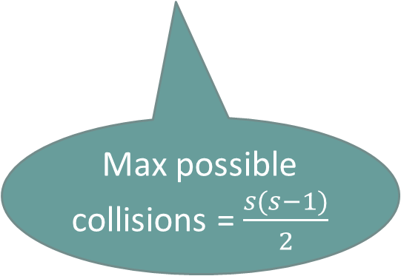
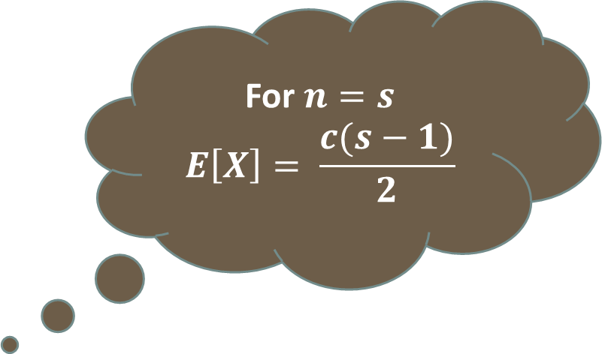
Optimal space hashing and O(1) worst case search time
Let $S$ be any set of size $s$.
Let $H$be a c-Universal Hash Family.
$X$: no. of collisions for $S$ when $h∈_{r}H$
Question: What is $E[X]$?
For $n=s$
$$E\left[X\right]= \frac{c(s−1)}{2}$$
$$= \frac{c}{n}×\frac{s(s−1)}{2}$$
Max possible collisions = $\frac{s(s−1)}{2}$

Slide 17
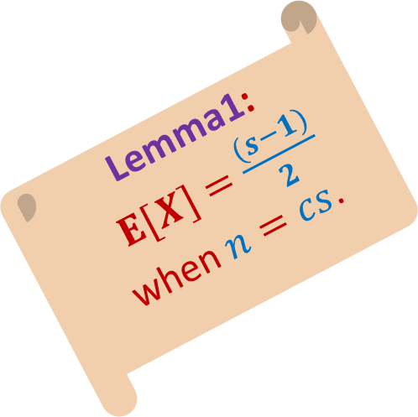
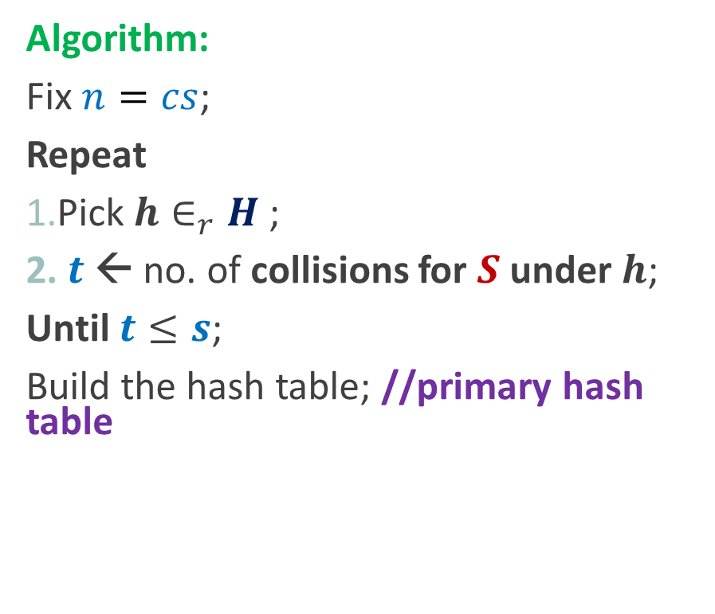
Optimal space hashing and O(1) worst case search time
Algorithm:
Fix $n=cs$;
Repeat
Pick $h∈_{r}H$;
$t$← no. of collisions for $S$ under $h$;
Until $t≤s$;
Build the hash table; //primary hash table
Lemma1:$E[X]=\frac{(s−1)}{2}$ when $n=cs$.

Slide 18


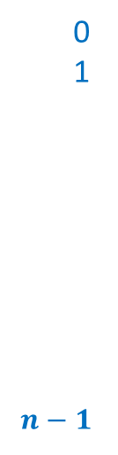
Optimal space hashing and O(1) worst case search time
Algorithm:
Fix $n=cs$;
Repeat
Pick $h∈_{r}H$;
$t$← no. of collisions for $S$ under $h$;
Until $t≤s$;
Build the hash table; //primary hash table
$$T$$
0
1
$$n−1$$

Slide 19

Optimal space hashing and O(1) worst case search time
Algorithm:
Fix $n=cs$;
Repeat
Pick $h∈_{r}H$;
$t$← no. of collisions for $S$ under $h$;
Until $t≤s$;
Build the hash table; //primary hash table
$$T$$
0
1
$$n−1$$

Slide 20
Optimal space hashing and O(1) worst case search time
Algorithm:
Fix $n=cs$;
Repeat
Pick $h∈_{r}H$;
$t$← no. of collisions for $S$ under $h$;
Until $t≤s$;
Build the hash table; //primary hash table
0
1
$$n−1$$

Slide 21
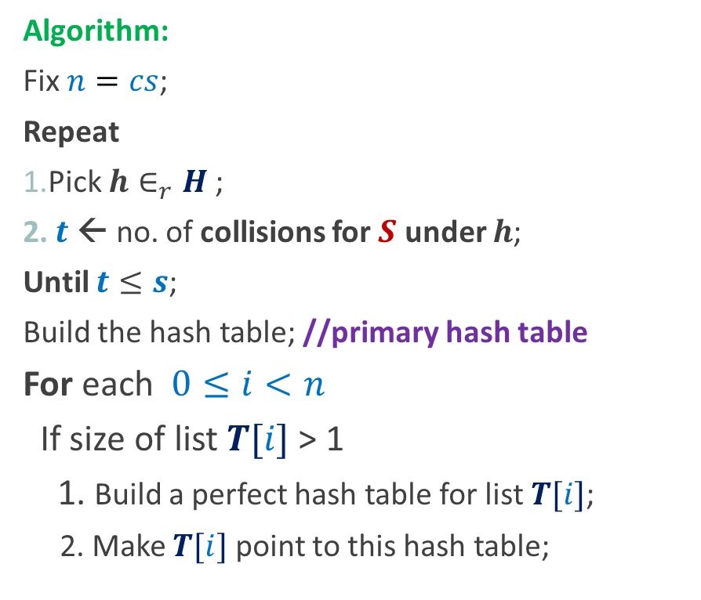
Optimal space hashing and O(1) worst case search time
Algorithm:
Fix $n=cs$;
Repeat
Pick $h∈_{r}H$;
$t$← no. of collisions for $S$ under $h$;
Until $t≤s$;
Build the hash table; //primary hash table
For each $0≤i<n$
If size of list $T[i]$ > 1
1. Build a perfect hash table for list $T[i]$;
2. Make $T[i]$ point to this hash table;
0
1
$$n−1$$

Slide 22
Optimal space hashing and O(1) worst case search time
$$T$$
0
1
$$n−1$$
0
1
$$n−1$$

Slide 23
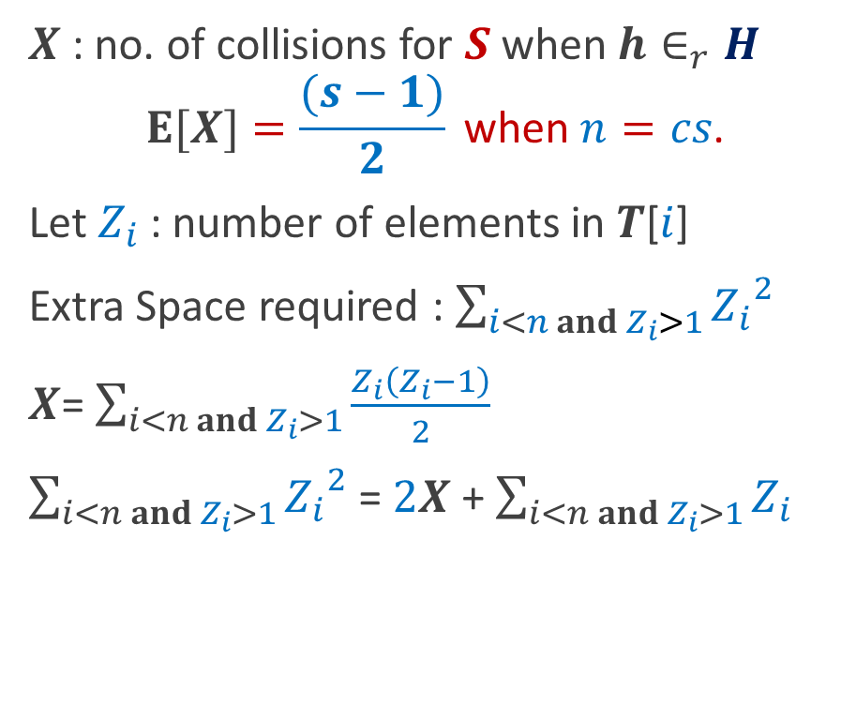
Optimal space hashing and O(1) worst case search time
$X$: no. of collisions for $S$ when $h∈_{r}H$
$$E[X]=\frac{(s−1)}{2} \text{when} n=cs\text{.}$$
Let $Z_{i}$ : number of elements in $T$[$i$]
Extra Space required : $\sum_{i<n and{ Z}_{i}>1}{{Z_{i}}^{2}}$
$X$= $\sum_{i<n and Z_{i}>1}{\frac{Z_{i}\left(Z_{i}−1\right)}{2}}$
$\sum_{i<n and Z_{i}>1}{{Z_{i}}^{2}}$ = $2X$ + $\sum_{i<n and{ Z}_{i}>1}{Z_{i}}$
0
1
$$n−1$$

Slide 24
Optimal space hashing and O(1) worst case search time
Algorithm:
Fix $n=cs$;
Repeat
Pick $h∈_{r}H$;
$t$← no. of collisions for $S$ under $h$;
Until $t≤s$;
Build the hash table; //primary hash table
For each $0≤i<n$
If size of list $T[i]$ > 1
1. Build a perfect hash table for list $T[i]$;
2. Make $T[i]$ point to this hash table;
0
1
$$n−1$$

Slide 25

Optimal space hashing and O(1) worst case search time
$X$: no. of collisions for $S$ when $h∈_{r}H$
$$E[X]=\frac{(s−1)}{2} \text{when} n=cs\text{.}$$
Let $Z_{i}$ : number of elements in $T$[$i$]
Extra Space required : $\sum_{i<n and{ Z}_{i}>1}{{Z_{i}}^{2}}$
$X$= $\sum_{i<n and Z_{i}>1}{\frac{Z_{i}\left(Z_{i}−1\right)}{2}}$
$\sum_{i<n and Z_{i}>1}{{Z_{i}}^{2}}$ = $2X$ + $\sum_{i<n and{ Z}_{i}>1}{Z_{i}}$
0
1
$$n−1$$
$$≤3s$$

Slide 26
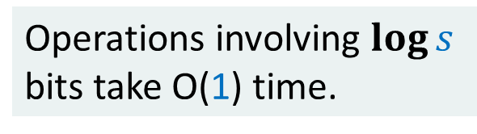
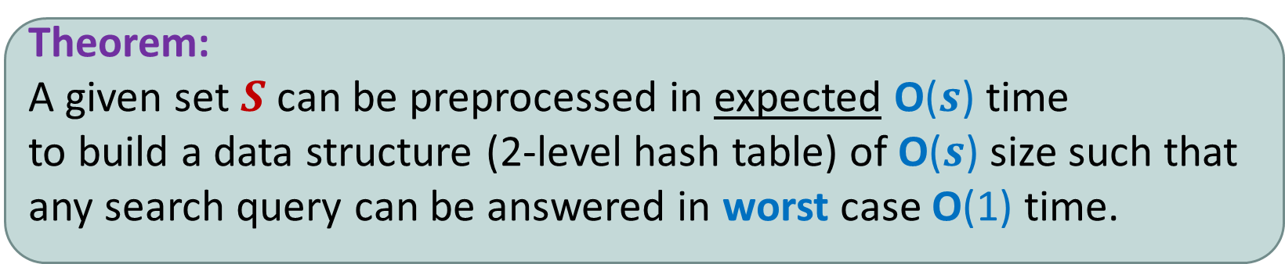


Optimal space hashing and O(1) worst case search time
Theorem:
A given set $S$can be preprocessed in expected O($s$) time
to build a data structure (2-level hash table) of O($s$) size such that
any search query can be answered in worst case O(1) time.
Operations involving $\log{s}$
bits take O(1) time.
Model of Computation:
Word RAM
$$m=polynomial(s)$$
$$\log{m}=O(\log{s})$$

Slide 27

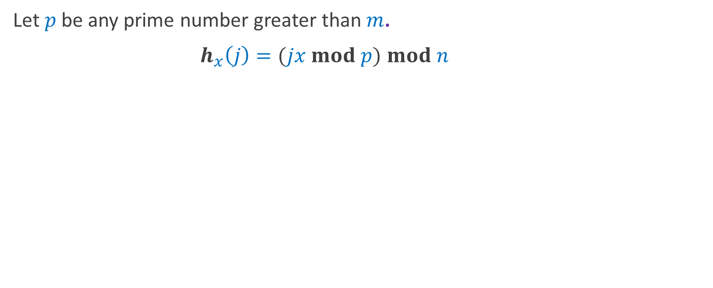
Universal Hash Family
Let $p$be any prime number greater than $m$.
$h_{x}\left(j\right)=(jx mod p)$ $mod n$
Theorem: H={$h_{x}$| $1≤x≤p−1$} is universal.

Slide 28

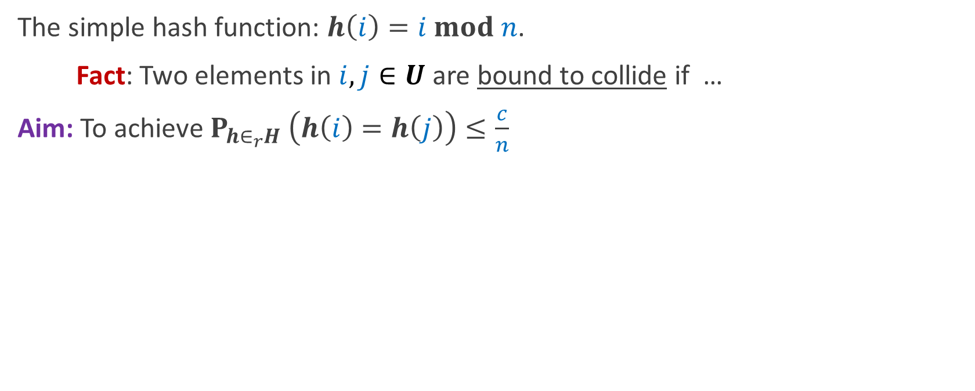
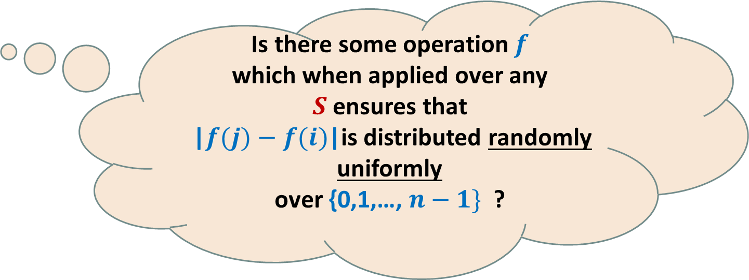
Universal Hash Family (starting point)
The simple hash function: $h\left(i\right)=i mod n$.
Fact: Two elements in $i,j∈U$ are bound to collide if …
Aim: To achieve $P_{h∈_{r}H} \left(h\left(i\right)=h\left(j\right)\right)≤\frac{c}{n}$
$n$ divides |$j−i$|.
Is there some operation $f$
which when applied over any $S$ensures that
|$f(j)−f(i)$|is distributed randomly uniformly
over {0,1,…, $n−1\}$ ?

Slide 29
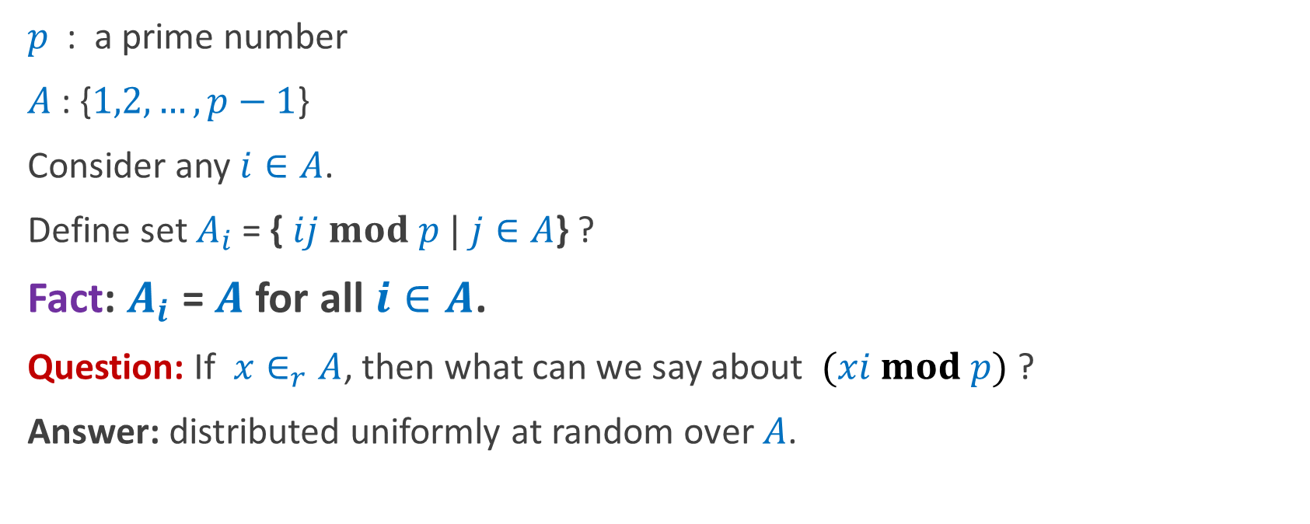
Universal Hash Family
$p$ : a prime number
$A$: {$1,2,…,p−1$}
Consider any $i∈A$.
Define set $A_{i}$ = { $ij mod p |$ $j∈A$} ?
Fact: $A_{i}$ = $A$ for all $i∈A$.
Question: If $x∈_{r}A$, then what can we say about $(xi mod p)$?
Answer: distributed uniformly at random over $A$.

Slide 30
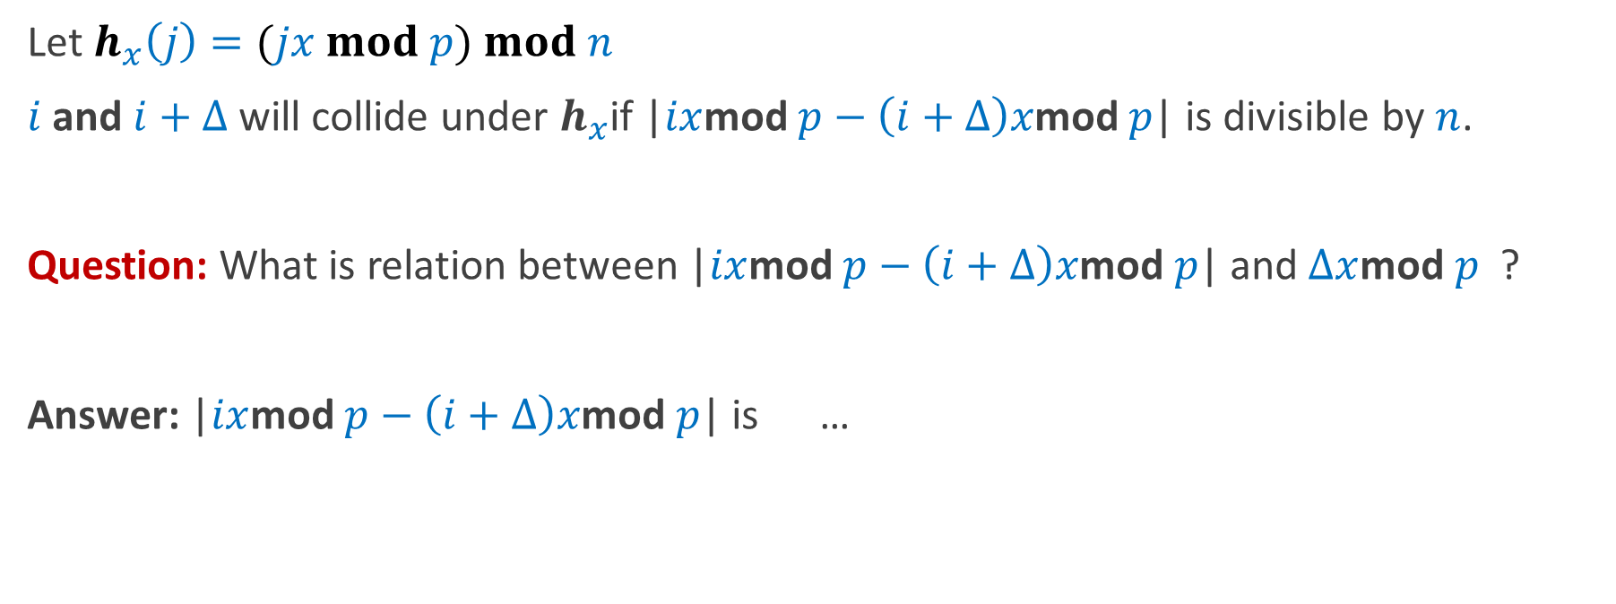
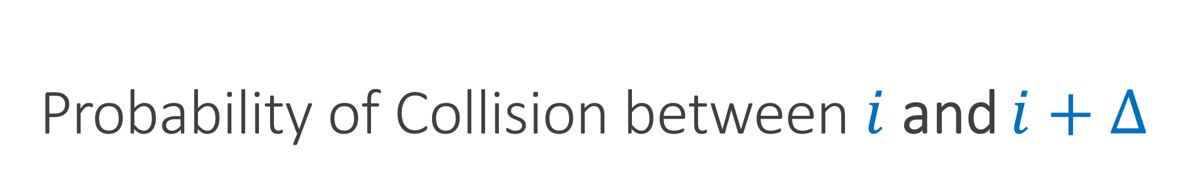

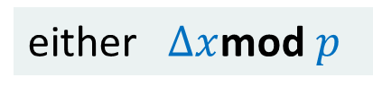
Probability of Collision between $i$ and $i+Δ$
Let $h_{x}\left(j\right)=(jx mod p) mod n$
$i$ and $i+Δ$ will collide under $h_{x}$if |$ix$mod $p−\left(i+Δ\right)x$mod $p$| is divisible by $n$.
Question: What is relation between |$ix$mod $p−\left(i+Δ\right)x$mod $p$| and $Δx$mod $p$ ?
Answer: |$ix$mod $p−\left(i+Δ\right)x$mod $p$| is …
either $Δx$mod $p$
or $p−Δx\text{mod} p$.

Slide 31
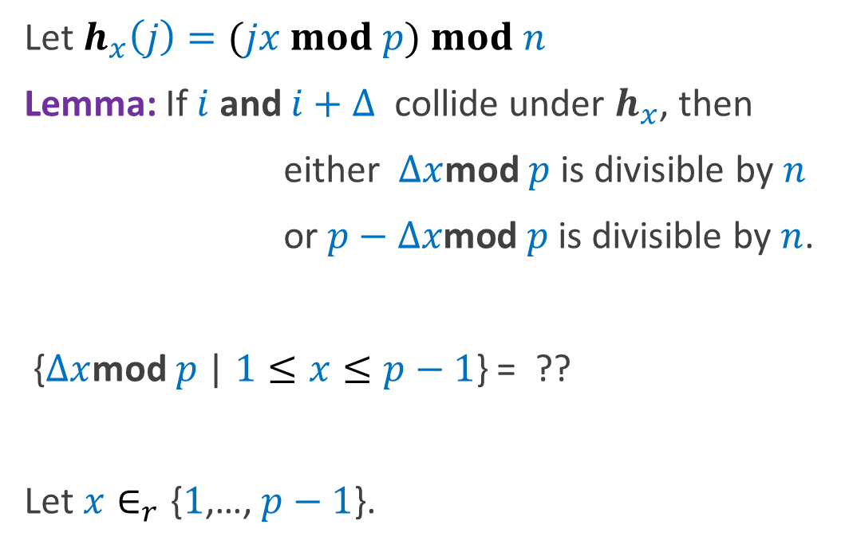
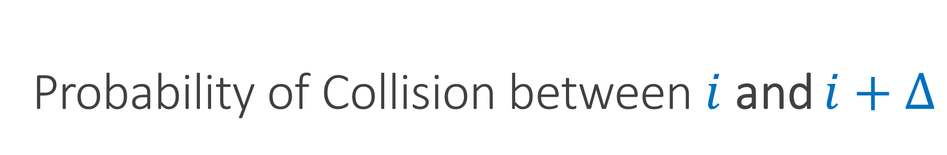
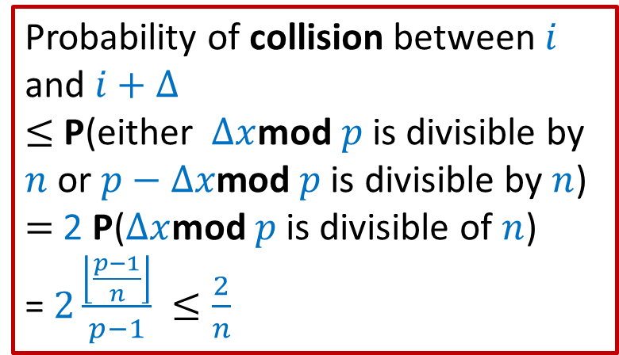
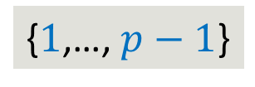
Probability of Collision between $i$ and $i+Δ$
Let $h_{x}\left(j\right)=(jx mod p) mod n$
Lemma: If $i$ and $i+Δ$ collide under $h_{x}$, then
either $Δx$mod $p$ is divisible by $n$
or $p−Δx\text{mod} p$ is divisible by $n$.
{$Δx$mod $p$ | $1≤x≤p−1$} = ??
Let $x∈_{r}\text{\{}1\text{,…,} p−1\text{\}}$.
Probability of collision between $i$ and $i+Δ$
$≤$ P(either $Δx$mod $p$ is divisible by $n$ or $p−Δx\text{mod} p$ is divisible by $n$)
$=$ 2 P($Δx$mod $p$ is divisible of $n$)
= $2\frac{\left\lfloor \frac{p−1}{n}\right\rfloor }{p−1} ≤\frac{2}{n}$
{$1$,…, $p−1$}

Slide 32

Universal Hash Family
Let $p$be any prime number greater than $m$.
$h_{x}\left(j\right)=(jx mod p)$ $mod n$
Theorem: H={$h_{x}$| $1≤x≤p−1$} is 2-universal.

Slide 33
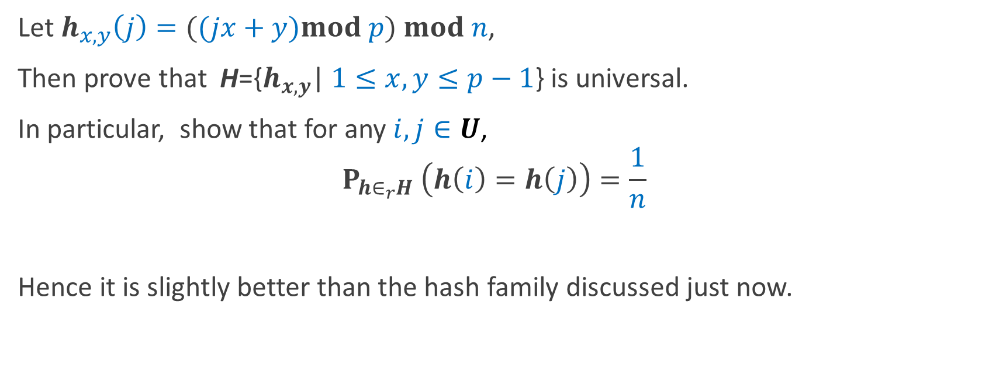
Universal Hash Family (Exercise)
Let $h_{x,y}\left(j\right)=((jx+y)mod p) mod n$,
Then prove that H={$h_{x,y}$| $1≤x,y≤p−1$} is universal.
In particular, show that for any $i,j∈U$,
$$P_{h∈_{r}H} \left(h\left(i\right)=h\left(j\right)\right)=\frac{1}{n}$$
Hence it is slightly better than the hash family discussed just now.

Slide 34
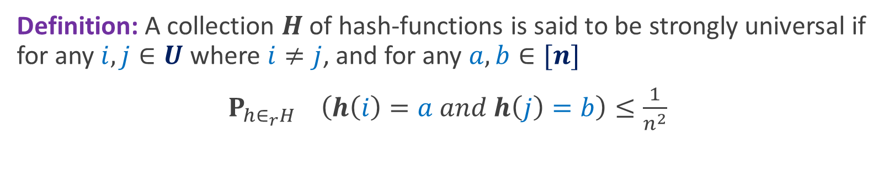
Strong Universal Hash Family
Definition: A collection $H$of hash-functions is said to be strongly universal if for any $i,j∈U$ where $i≠j$, and for any $a,b∈[n]$
$P_{h∈_{r}H} \left(h\left(i\right)=a and h\left(j\right)=b\right)≤\frac{1}{n^{2}}$
Gives pair-wise independence guarantee

Slide 35
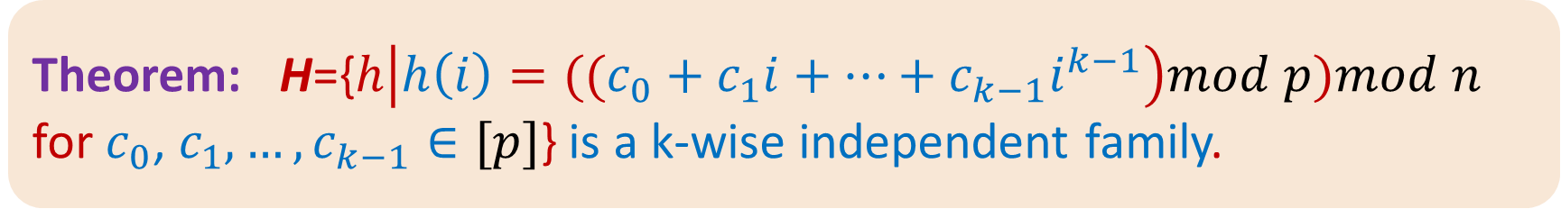
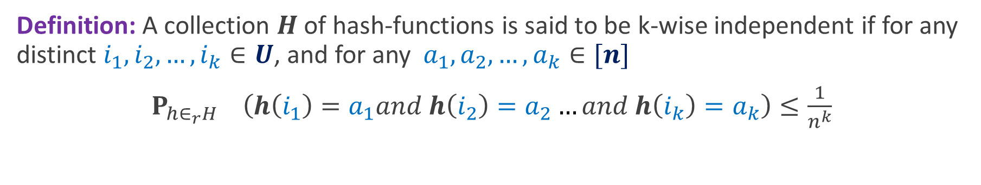
K-wise Independent Hash Family
Definition: A collection $H$of hash-functions is said to be k-wise independent if for any distinct $i_{1},i_{2},…,i_{k}∈U$, and for any$a_{1},a_{2},…,a_{k}∈[n]$
$P_{h∈_{r}H} \left(h\left(i_{1}\right)=a_{1}and h\left(i_{2}\right)=a_{2}…and h\left(i_{k}\right)=a_{k}\right)≤\frac{1}{n^{k}}$
Theorem: H={$h\left|h\left(i\right)=((c_{0}+c_{1}i+…+c_{k−1}i^{k−1}\right)mod p)mod n$ for $c_{0}$, $c_{1},…,c_{k−1}∈[p]$} is a k-wise independent family.

Slide 36
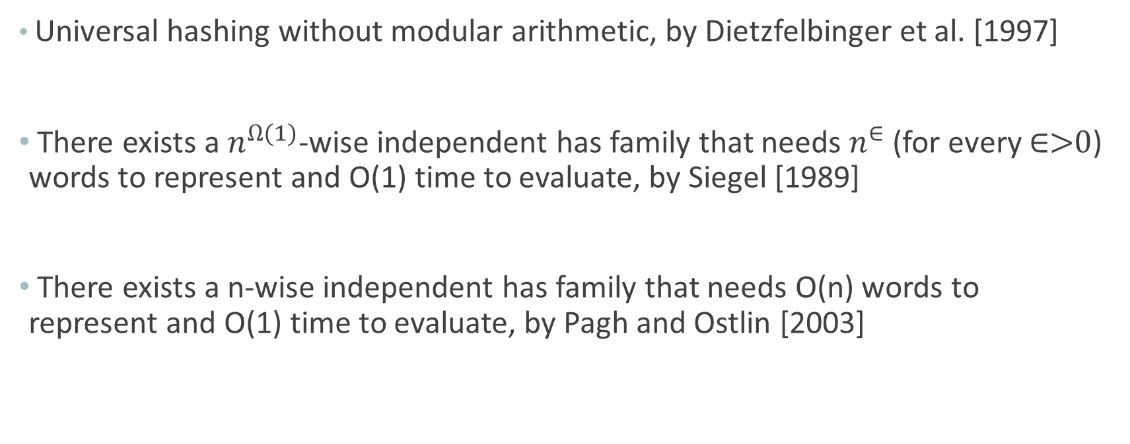
A few important results
Universal hashing without modular arithmetic, by Dietzfelbinger et al. [1997]
There exists a $n^{Ω(1)}$-wise independent has family that needs $n^{∈}$ (for every ∈>0) words to represent and O(1) time to evaluate, by Siegel [1989]
There exists a n-wise independent has family that needs O(n) words to represent and O(1) time to evaluate, by Pagh and Ostlin [2003]

Slide 37
Cuckoo Hashing – Dynamic hashing
Question: How can we maintain a dynamic set such that
  O(1) expected amortized time for insert
  O(1) worst-case time for query/delete
  Cuckoo Hashing introduced by R. Pagh and F. Rodler [2001]
Named after nesting habits of Cuckoo bird, which lays its eggs in other birds’ nests, bumping out the eggs that are originally there

Slide 38
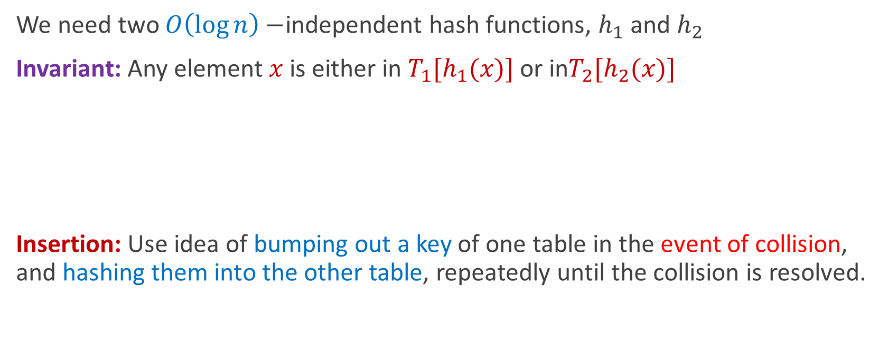
Cuckoo Hashing
We need two $O\left(\log{n}\right)−$independent hash functions, $h_{1}$ and $h_{2}$
Invariant: Any element $x$ is either in $T_{1}[h_{1}(x)]$ or in$T_{2}[h_{2}(x)]$
Insertion: Use idea of bumping out a key of one table in the event of collision, and hashing them into the other table, repeatedly until the collision is resolved.
Time to query/delete = O(1)

Slide 39
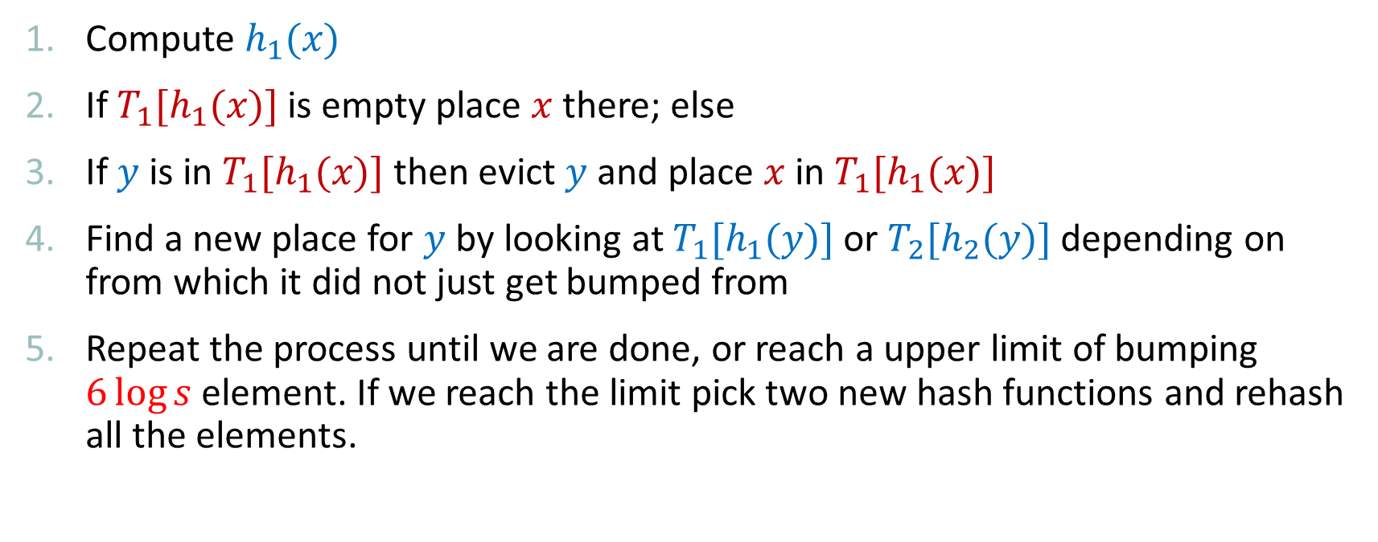
Cuckoo Hashing – Insertion(x)
Compute $h_{1}(x)$
If $T_{1}[h_{1}(x)]$ is empty place $x$ there; else
If $y$ is in $T_{1}[h_{1}(x)]$ then evict $y$ and place $x$ in $T_{1}[h_{1}(x)]$
Find a new place for $y$ by looking at $T_{1}[h_{1}(y)]$ or $T_{2}[h_{2}(y)]$ depending on from which it did not just get bumped from
Repeat the process until we are done, or reach a upper limit of bumping $6\log{s}$ element. If we reach the limit pick two new hash functions and rehash all the elements.
Isn’t it simple?

Slide 40
Cuckoo Hashing – Insertion(x)
Why is insertion fast?
Generally no. of elements get bumped is very small
How do we analyze?

Slide 41
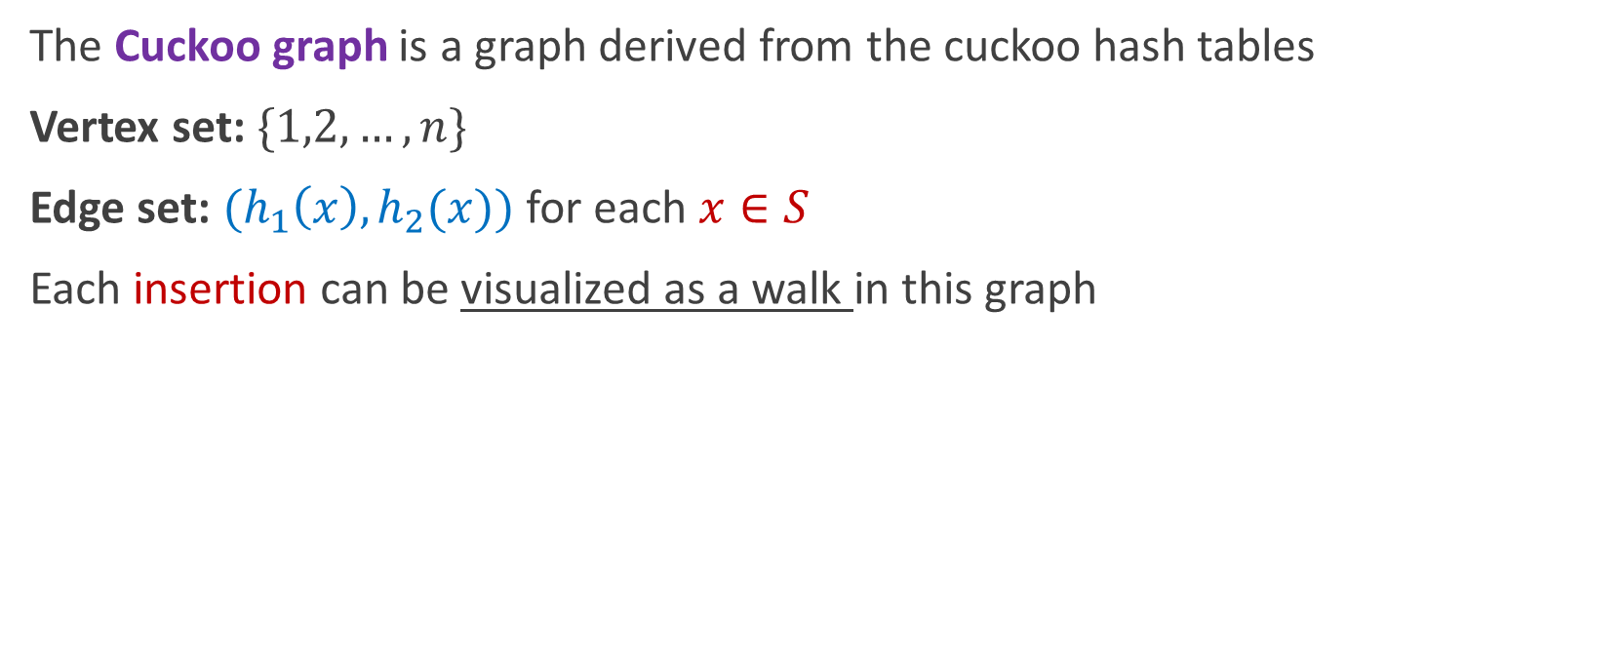
Cuckoo Graph
The Cuckoo graph is a graph derived from the cuckoo hash tables
Vertex set: $\{1,2,…,n\}$
Edge set: $(h_{1}\left(x\right),h_{2}(x))$ for each $x∈S$
Each insertion can be visualized as a walk in this graph

Slide 42

Analysis: Case 1

Slide 43

Analysis: Case 2

Slide 44

Analysis: Case 3

Slide 45
Cuckoo Hashing: Final analysis
Insertion time=
P(Rehash)(O(log s) + s . Insertion time) + (1 - P(Rehash)) O(1)
=O(1/s) . Insertion time + O(1)
So overall amortized insertion time is O(1) in expectation

Slide 46
Acknowledgement
Some portion of this slides are modified from the slides prepared by Prof. Surender Baswana
Some contents and figures are taken from lecture note of Prof. Erik Demaine

